Slide 1
CLOUD ++

Slide 2
Client-Server Communication
C++ server listens on TCP port 8080, accepts client sessions in separate threads, and supports commands like REGISTER,LOGIN,DELETE,UPLOAD,
DOWNLOAD,RESTORE,SHARE.
It uses WinSock for networking, threading for concurrency, mutexes for thread safety, filesystem to track user storage, and logs all actions with timestamps. Custom classes manage authentication and storage quotas.

Slide 3
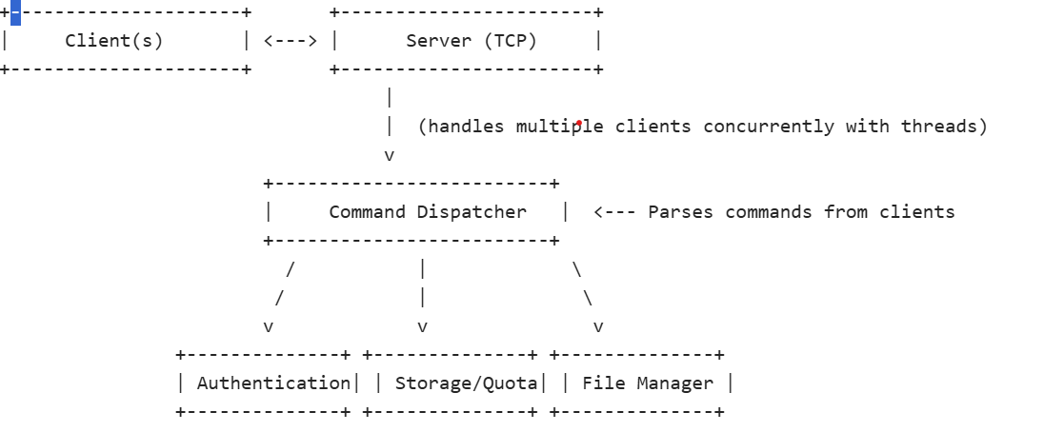
Architectural Diagram

Slide 4
Authentication: manages user registration/login.
-Storage/Quota: tracks user quotas, updates on upload/delete (user.txt,loginlog.txt,upload.txt,report.txt)
. File Manager: handles upload/download/delete/trash/share/restore like user to store
Command Dispatcher-client sent command like LOGIN,UPLOAD,REGISTER,DOWNLOAD,
SHARE, DELETE,TRASH etc..

Slide 5
Pseudocode
start_server:
initialize_winsock()
create_listening_socket()
bind_socket(port=8080)
listen_for_connections()
while true:
client_socket = accept_connection()
start_thread(client_handler, client_socket)
client_handler(sock):
while connection_alive: request = recv(sock) command, params = parse_request(request)
switch
command: case "REGISTER": result = auth.registerUser(params)
if result: quota.addUser(username)
send_response(sock, "REGISTER_SUCCESS"/"REGISTER_FAILED")
case "LOGIN": result = auth.loginUser(params) send_response(sock, "LOGIN_SUCCESS"/"LOGIN_FAILED")

Slide 6
case "UPLOAD": if quota.canUpload(user, size):
send_response(sock, "READY") receive_file(sock, filename, size) update_quota(user, size) send_response(sock, "UPLOAD_SUCCESS")
else: send_response(sock,"UPLOAD_FAILED_QUOTA_EXCEEDED")
case "DOWNLOAD": send_file(sock, filename)
case "DELETE": move_file_to_trash(filename) update_quota_on_delete(user, fileSize) send_response(sock, "DELETE_SUCCESS")
case "TRASH": move_file_to_permanent_delete(filename) update_quota_on_delete(user, fileSize) send_response(sock, "PERMANENT_DELETE_SUCCESS")
case "SHARE": if receiver exists and quota allows: copy_file_to_receiver_inbox() update_receiver_quota() send_response(sock, "SHARE_SUCCESS") else: send_response(sock, "SHARE_FAILED_*")

Slide 7
case "RESTORE": if quota allows: move_file_from_trash_to_storage() update_quota_on_restore()
send_response(sock, "RESTORE_SUCCESS")
case "LIST": files = list_files_in_user_storage() send_response(sock, files or "NO_FILES")
case "LOGOUT": send_response(sock, "LOGOUT_SUCCESS") close_connection()
default: send_response(sock, "UNKNOWN_COMMAND")

Slide 8
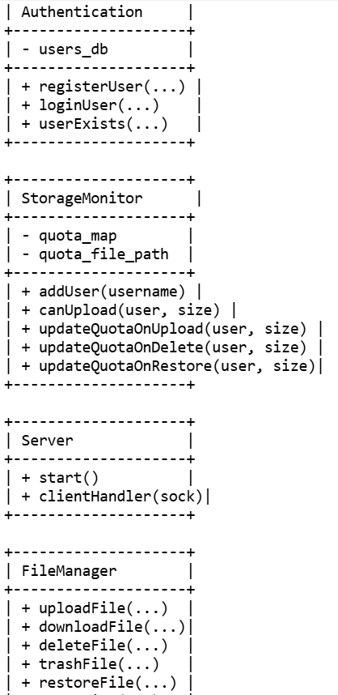
Class Diagram

Slide 9

Libraries Used and Their Roles
<windows.h> Core Windows API
<winsock2.h> Winsock2 API for TCP/IP socket networking
<ws2tcpip.h> Additional TCP/IP helper functions (e.g. inet_pton)
<iostream> Standard C++ IO streams for console output
<sstream> String stream utilities for parsing
<fstream> File stream for reading/writing files <thread> Thread support for concurrent client handling
<mutex> Mutex for thread-safe console output
<filesystem> C++17 filesystem operations for file and folder management
<algorithm> Standard algorithms (used here for min)

Slide 10
Server vs Admin
This is a console-based
admin interface that lets a system administrator
: View user behavior and file uploads
Check logs Run cleanup or backup tasks
Access to Admin dashboard after login

Slide 11
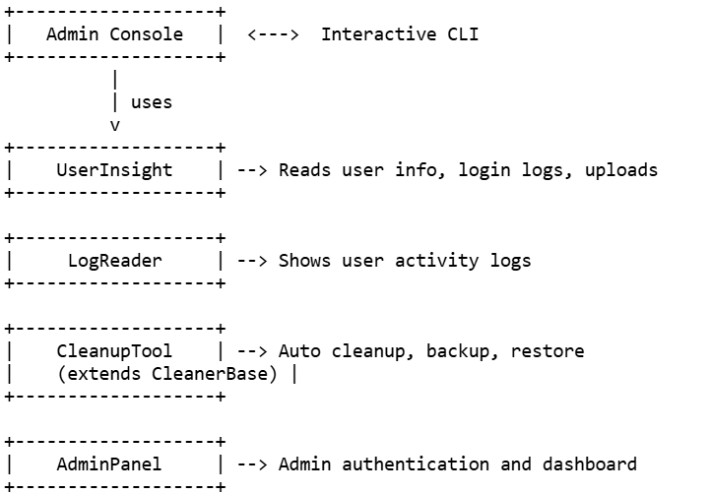
Architecture diagram

Slide 12
pseudocode
Main: -
Load modules: UserInsight, LogReader, CleanupTool, AdminPanel
- Show menu: 1. User Insights 2. User Activity Log 3. Cleanup Tool 4. Admin Panel 5. Exit –
Loop and handle user input –
If User Insights: Ask for username Call insight.showUserDetails(username)
- If User Activity Log: Call logReader.showUserActivity(username)
- If Cleanup Tool: Submenu for:
- Auto cleanup - Create backup - List backups - Restore backup –
Set storage limit
If Admin Panel: Ask for login Call admin.validate(user, pass)
If valid: showDashboard()

Slide 13
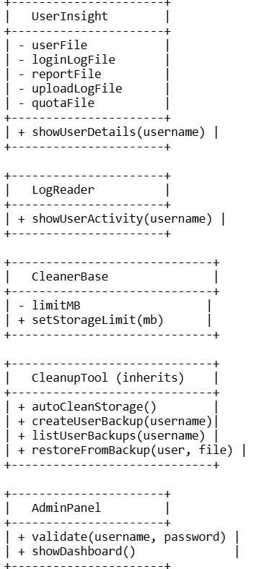
Class Diagram

Slide 14
Libraries Used Header Purpose
iostream> Console input/output
<string> Standard C++ string handling
<limits> (assumed) Used for std::numeric_limits

Slide 15
Future Implementation
Add quota(premium packages).
Send notifications.
All admin duties are done by Automatic.
Use to connect multiple network for clients
Recover data while it permanat delet.

